Slide 1
Use Case Map Support for Touchcore
Jerry Yu-Chieh Wei
COMP 396

Slide 2
The Project
Implement UCM in TouchCORE
Before TouchCORE was only supported with Impact, Feature, and Ram Models
Enables one to address non-functioning & functional requirements
Used EMF to create UCM metamodel
Application functions through Views, Handlers, and Controllers
Build interface to support user interaction with elements
Integrate new extension into existing TouchCORE application
Allow users to create UCM path
Start node, responsibility, end node
Notes:
GImpact, Feature, and Ram Models = RL models

Slide 3
Analysis Requirements
Expand CORE metamodel to support UCM
Create views to represent each visual elements (path nodes, diagrams, scenes, icons, etc)
Build controllers to execute commands/modify UCM model
Construct handlers to handle user interaction
Utilize existing touch gesture functionality of TouchCORE to interface with the program
Enable saving and loading of a UCM model
Allow users to associate UCM models with features
Utilize Layout Map/Layout Element to save view positions
Notes:
Looking at the task , identify what prerequisites are essential to completing the project

Slide 4
Pre-existing Tools
TouchCORE
Multi-Touch for Java provided array of various touch actions
No new touch signals had to be developed
Aspect models as example of a realisation model

Slide 5
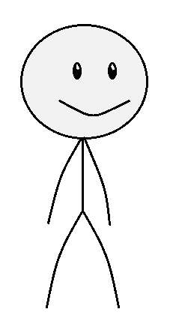
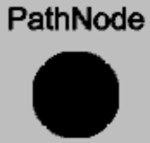
TouchCORE 101
Interfaces screen
USER
HANDLER
Handles User Gestures
Creates & Executes Commands to edit models
VIEW
CONTROLLER
(Representation of Model on Display)

Slide 6
TouchCORE 101:
VIEW
HANDLER
CONTROLLER
Any visual element
Any element modified by user through GUI
Any element that requires editing model data

Slide 7
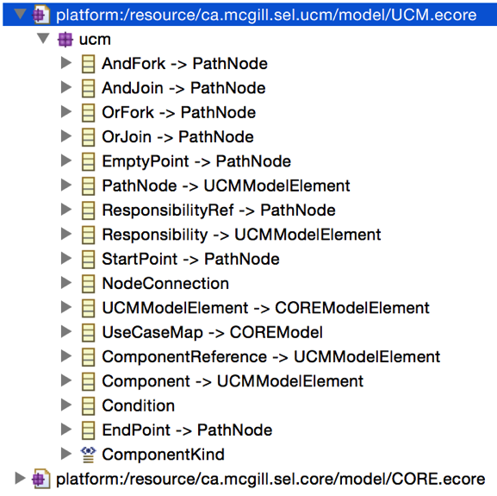
UCM Metamodel
Renamed version in Ecore before layout map addition

Slide 8
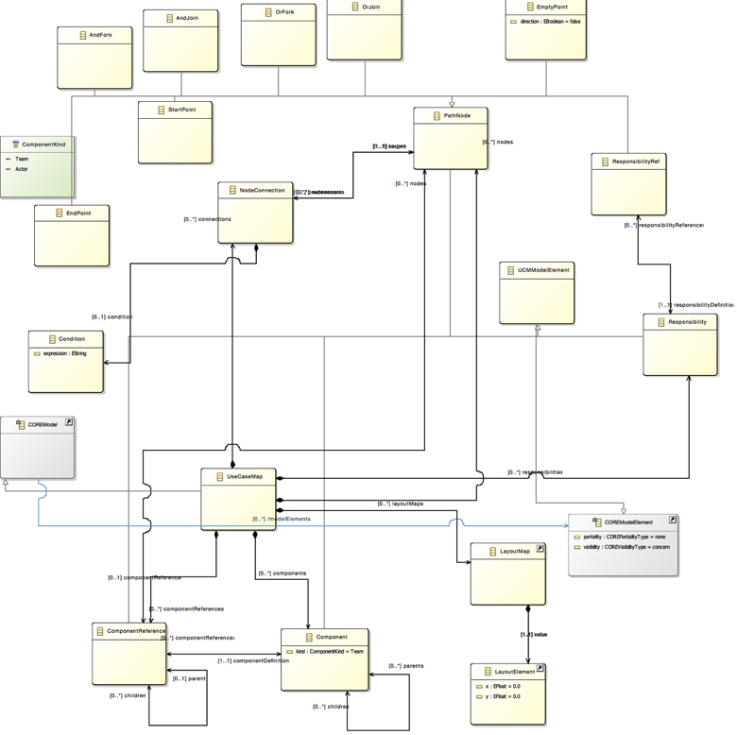
UCM Metamodel (with LayoutMap)

Slide 9
StartPointView in TouchCORE UCM
Visual representation of StartPoint in UCM
RamRectangleComponent through type hierarchy
Two ContainerComponents
One has TextView to display name
Other has RamRoundedRectangleComponent

Slide 10
PathNode
!!!Optional text to be added!!!

Slide 11
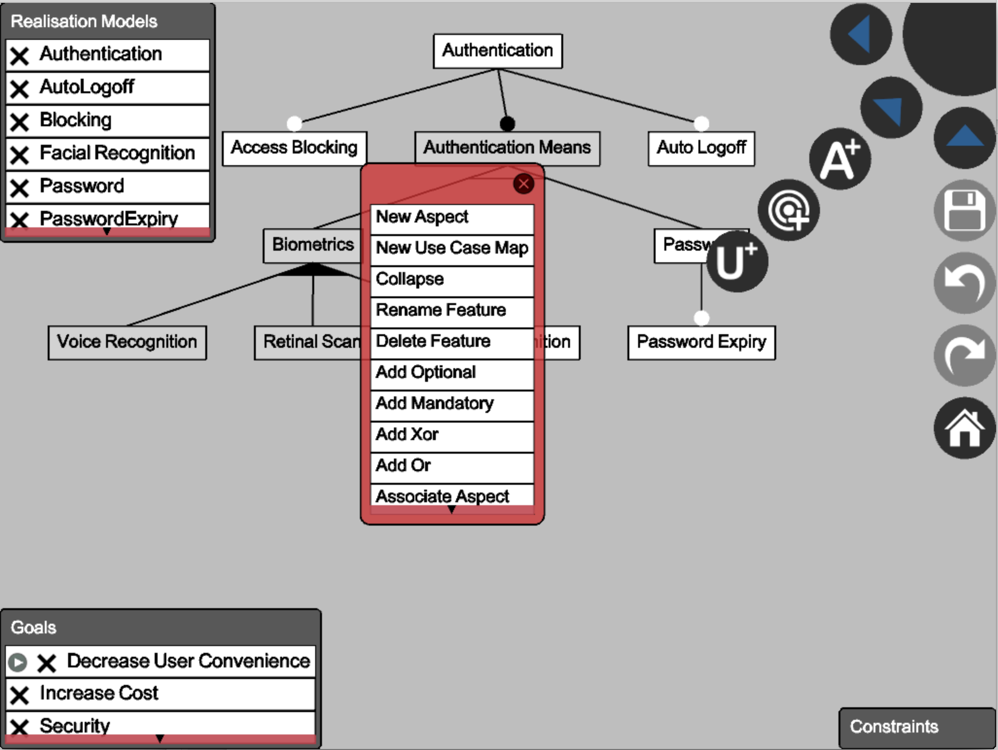

Slide 12
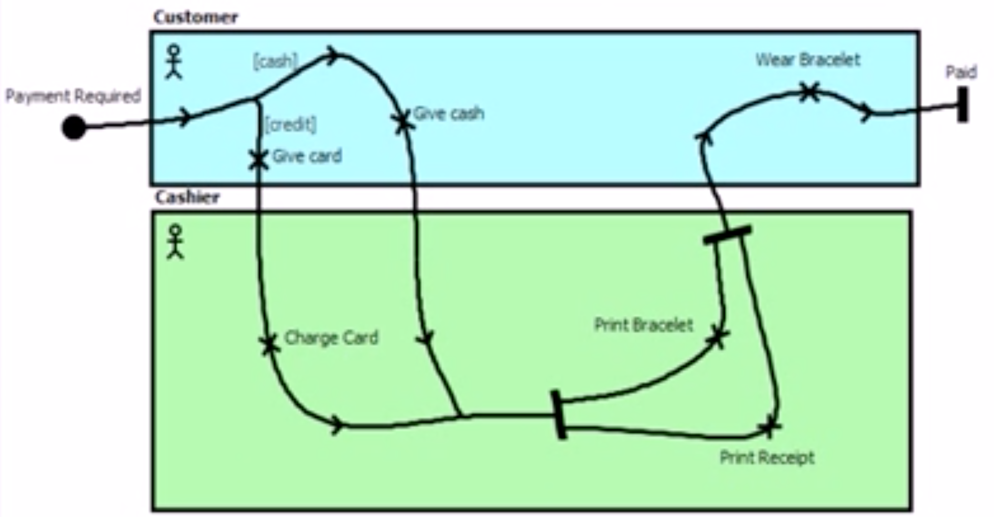
UCM in jUCMNav

Slide 13
Implementation
UCM Metamodel
PathNode and its Views, Controller and Handler
UCMDiagramView
NodeConnectionView
NodeConnectionView Constraints
DisplayUCMScene
Integrating UCM with TouchCORE
Saving View Positions

Slide 14
Future Work
Create remaining path nodes
AndFork, AndJoin, OrFork, OrJoin, ComponentRef, etc.
Implement EditPoint
Construct a RespondibilityPanel
‘Future-proof’ TouchCORE
New classes to UCM
Aspect-oriented support

